Slide 1

20AIM72A Web Technology Jimsha K Mathew SAP/AIML/NHCE

Slide 2
MODULE-V
Arrays and Super globals: Arrays, $_GET and $_POST, Super global Arrays, $_SERVER Array, $_Files Array, Reading/Writing Files. Node.js: Introduction to Node.js, process model, modules and its types, webserver, files system,

Slide 3
ARRAYS IN PHP

Slide 4
Contents
Why Arrays?
PHP Indexed (Numeric) Arrays
PHP Associative Arrays
PHP 2D Arrays
PHP 3D Arrays
Array Sorting
Associate Array Sorting
PHP Array Functions

Slide 5
Create an Array in PHP
In PHP, there are three types of arrays:
Indexed arrays - Arrays with a numeric index
Associative arrays - Arrays with named keys
Multidimensional arrays - Arrays containing one or more arrays

Slide 6
The count() function is used to return the length (the number of elements) of an array:

Slide 7

How to create an indexed array?
PHP Indexed (Numeric) Arrays
An indexed or numeric array stores each
array element with a numeric index.
It uses number as access keys.
The access key is used whenever we want to read or assign a new value an array element.
Syntax-1
<?php
$array_name[n] = value;
?>
“$array_name…” is the name of the variable
<?php
$student [4]= ("Ratheesh", "Satheesh", "Sudheesh", "Bijeesh");
?>
or
<?php
$student[0] = "Ratheesh";
$student[1] = "Satheesh";
$student[2] = "Sudheesh";
$student[3] = "Bijeesh";
?>
or
<?php
$student = array(0=> "Ratheesh", 1=>"Satheesh", 2=>"Sudheesh", 3=>"Bijeesh");
?>
How to display an indexed array?
<?php
“[n]” is the access index number of the element
Output
“value” is the value assigned to the array
element.
for($i=0; $i<4; $i++) {
echo $student[$i]."<br>"; }
?>

Slide 8
How to create an associative array?
PHP Associative Arrays
Associative arrays are arrays that use
named keys that you assign to them.
In an associative array, the keys assigned to values can be arbitrary and user defined strings.
<?php
$mark_list["Ratheesh"] =98 ;
$mark_list["Satheesh"] =58;
$mark_list["Sudheesh"] =76 ;
?>
Syntax-1
<?php
$array_name['key_name'] = value;
?>
“$array_name…” is the name of the variable
“['key_name']” is the access index number of
the element
“value” is the value assigned to the array
element.
<?php
$mark_list = array("Ratheesh"=> 98 ,
"Satheesh"=> 58,
"Sudheesh"=> 76);
?>

Slide 9
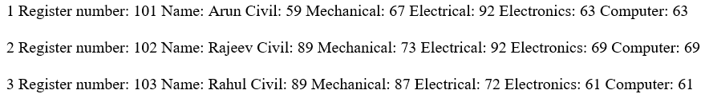
PHP 2D Arrays
<?php
PHP Multidimensional Arrays
$student_details = array(
array(101, "Arun", 59, 67,92,63,78),
array(102, "Rajeev", 89, 73,92,69,68),
array(103, "Rahul", 89, 87,72,61,68)
A multidimensional array is an array containing one or more arrays.
PHP supports multidimensional arrays that are two, three, four, five, or more levels deep.
Example for 2D array:
);
for($i=0;$i<3;$i++)
{
echo (($i+1)." Register number: ". $student_details[$i][0]); echo (" Name: ".$student_details[$i][1]);
echo (" Civil: ".$student_details[$i][2]);
echo ("
echo ("
echo ("
Mechanical: ".$student_details[$i][3]); Electrical: ".$student_details[$i][4]); Electronics: ".$student_details[$i][5]);
array(
array(101, "Arun", 59, 67,92,63,78),
array(102, "Rajeev", 89, 73,92,69,68),
array(103, "Rahul", 89, 87,72,61,68)
echo (" Computer: ".$student_details[$i][5]."<br><br>");
}
?>
Output
);

Slide 10

Array Sorting
PHP Functions For Sorting Arrays
<?php
$student = ["Ratheesh", "Satheesh", "Sudheesh", "Bijeesh"]; sort($student);
echo "After sorting in ascending order (Using foreach loop)<br>"; foreach($student as $name)
{
echo $name."<br>";
}
PHP comes with a number of built-in functions for sorting array elements in different ways like alphabetically or numerically in ascending or descending order.
Most commonly used functions for sorting arrays.
sort() and rsort()
For sorting indexed arrays
asort() and arsort()
For sorting associative arrays by value
ksort() and krsort()
For sorting associative arrays by key
?>
Output

Slide 11
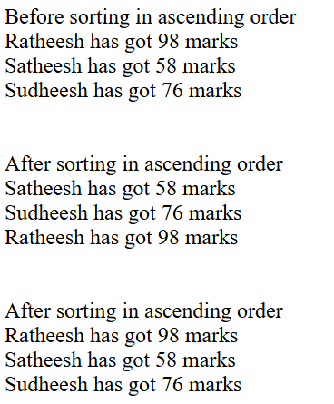
Associate Array Sorting
<?php
$mark_list = array("Ratheesh"=> 98 , "Satheesh"=> 58,"Sudheesh"=> 76);
echo "<br>Before sorting in ascending order)<br>";
foreach($mark_list as $name => $marks)
{
echo "$name has got $marks marks <br>";
}
asort($mark_list);
echo "<br><br>After sorting in ascending order br>";
foreach($mark_list as $name => $marks)
{
echo "$name has got $marks marks <br>";
}
ksort($mark_list);
echo "<br><br>After sorting in ascending order br>";
foreach($mark_list as $name => $marks)
{
echo "$name has got $marks marks <br>";
}
?>

Slide 12
PHP Array Functions
Function | Description
array() | Creates an array
array_change_key_case() | Changes all keys in an array to lowercase or uppercase
array_chunk() | Splits an array into chunks of arrays
array_column() | Returns the values from a single column in the input array
array_combine() | Creates an array by using the elements from one "keys" array and one "values" array
array_count_values() | Counts all the values of an array
array_diff() | Compare arrays, and returns the differences (compare values only)
array_diff_assoc() | Compare arrays, and returns the differences (compare keys and values)
array_diff_key() | Compare arrays, and returns the differences (compare keys only)
array_diff_uassoc() | Compare arrays, and returns the differences (compare keys and values, using a user-defined key comparison function)
array_diff_ukey() | Compare arrays, and returns the differences (compare keys only, using a user-defined key comparison function)
array_fill() | Fills an array with values
array_fill_keys() | Fills an array with values, specifying keys
array_filter() | Filters the values of an array using a callback function
array_flip() | Flips/Exchanges all keys with their associated values in an array

Slide 13
PHP Array Functions contd..
array_intersect() | Compare arrays, and returns the matches (compare values only)
array_intersect_assoc() | Compare arrays and returns the matches (compare keys and values)
array_intersect_key() | Compare arrays, and returns the matches (compare keys only)
array_intersect_uassoc() | Compare arrays, and returns the matches (compare keys and values, using a user-defined key comparison function)
array_intersect_ukey() | Compare arrays, and returns the matches (compare keys only, using a user-defined key comparison function)
array_key_exists() | Checks if the specified key exists in the array
array_keys() | Returns all the keys of an array
array_map() | Sends each value of an array to a user-made function, which returns new values
array_merge() | Merges one or more arrays into one array
array_merge_recursive() | Merges one or more arrays into one array recursively
array_multisort() | Sorts multiple or multi-dimensional arrays
array_pad() | Inserts a specified number of items, with a specified value, to an array
array_pop() | Deletes the last element of an array
array_product() | Calculates the product of the values in an array
array_push() | Inserts one or more elements to the end of an array
array_rand() | Returns one or more random keys from an array
array_reduce() | Returns an array as a string, using a user-defined function
array_replace() | Replaces the values of the first array with the values from following arrays
array_replace_recursive() | Replaces the values of the first array with the values from following arrays recursively

Slide 14
PHP Array Functions contd..
array_reverse() | Returns an array in the reverse order
array_search() | Searches an array for a given value and returns the key
array_shift() | Removes the first element from an array, and returns the value of the removed element
array_slice() | Returns selected parts of an array
array_splice() | Removes and replaces specified elements of an array
array_sum() | Returns the sum of the values in an array
array_udiff() | Compare arrays, and returns the differences (compare values only, using a user-defined key comparison function)
array_udiff_assoc() | Compare arrays, and returns the differences (compare keys and values, using a built-in function to compare the keys and a user-defined function to compare the values)
array_udiff_uassoc() | Compare arrays, and returns the differences (compare keys and values, using two user-defined key comparison functions)
array_uintersect() | Compare arrays, and returns the matches (compare values only, using a user-defined key comparison function)
array_uintersect_assoc() | Compare arrays, and returns the matches (compare keys and values, using a built-in function to compare the keys and a user- defined function to compare the values)
array_uintersect_uassoc() | Compare arrays, and returns the matches (compare keys and values, using two user-defined key comparison functions)
array_unique() | Removes duplicate values from an array
array_unshift() | Adds one or more elements to the beginning of an array
array_values() | Returns all the values of an array
array_walk() | Applies a user function to every member of an array
array_walk_recursive() | Applies a user function recursively to every member of an array
arsort() | Sorts an associative array in descending order, according to the value
asort() | Sorts an associative array in ascending order, according to the value
compact() | Create array containing variables and their values
count() | Returns the number of elements in an array
current() | Returns the current element in an array

Slide 15
PHP Array Functions contd..
each() | Returns the current key and value pair from an array
end() | Sets the internal pointer of an array to its last element
extract() | Imports variables into the current symbol table from an array
in_array() | Checks if a specified value exists in an array
key() | Fetches a key from an array
krsort() | Sorts an associative array in descending order, according to the key
ksort() | Sorts an associative array in ascending order, according to the key
list() | Assigns variables as if they were an array
natcasesort() | Sorts an array using a case insensitive "natural order" algorithm
natsort() | Sorts an array using a "natural order" algorithm
next() | Advance the internal array pointer of an array
pos() | Alias of current()
prev() | Rewinds the internal array pointer
range() | Creates an array containing a range of elements
reset() | Sets the internal pointer of an array to its first element
rsort() | Sorts an indexed array in descending order
shuffle() | Shuffles an array
sizeof() | Alias of count()
sort() | Sorts an indexed array in ascending order
uasort() | Sorts an array by values using a user-defined comparison function
uksort() | Sorts an array by keys using a user-defined comparison function
usort() | Sorts an array using a user-defined comparison function

Slide 16
PHP - Superglobal variables
Some predefined variables in PHP are "superglobals", which means that they are always accessible, regardless of scope - and you can access them from any function, class or file without having to do anything special.
The PHP superglobal variables are:
$GLOBALS
$_SERVER
$_REQUEST
$_POST
$_GET
$_FILES
$_ENV
$_COOKIE
$_SESSION

Slide 17
PHP $GLOBALS
$GLOBALS is a PHP super global variable which is used to access global variables from anywhere in the PHP script (also from within functions or methods).
PHP stores all global variables in an array called $GLOBALS[index]. The index holds the name of the variable.

Slide 18
<!DOCTYPE html> <html> <body> <?php $x = 75; $y = 25; function addition() { $GLOBALS['z'] = $GLOBALS['x'] + $GLOBALS['y']; } addition(); echo $z; ?> </body> </html>

Slide 19
PHP $_SERVER
$_SERVER is a PHP super global variable which holds information about headers, paths, and script locations.

Slide 20
<!DOCTYPE html> <html> <body> <?php echo $_SERVER['PHP_SELF']; echo "<br>"; echo $_SERVER['SERVER_NAME']; echo "<br>"; echo $_SERVER['HTTP_HOST']; echo "<br>"; echo $_SERVER['HTTP_REFERER']; echo "<br>"; echo $_SERVER['HTTP_USER_AGENT']; echo "<br>"; echo $_SERVER['SCRIPT_NAME']; ?> </body> </html>

Slide 21
PHP $_REQUEST
PHP $_REQUEST is a PHP super global variable which is used to collect data after submitting an HTML form.
The example below shows a form with an input field and a submit button. When a user submits the data by clicking on "Submit", the form data is sent to the file specified in the action attribute of the <form> tag.

Slide 22
<!DOCTYPE html> <html> <body> <form action="<?php echo $_SERVER['PHP_SELF'];?>"> Name: <input type="text" name="fname"> <input type="submit"> </form> <?php if ($_SERVER["REQUEST_METHOD"] == "POST") { // collect value of input field $name = htmlspecialchars($_REQUEST['fname']); if (empty($name)) { echo "Name is empty"; } else { echo $name; } } ?> </body> </html>

Slide 23
PHP $_POST
PHP $_POST is a PHP super global variable which is used to collect form data after submitting an HTML form with method="post". $_POST is also widely used to pass variables.
The example below shows a form with an input field and a submit button.
When a user submits the data by clicking on "Submit", the form data is sent to the file specified in the action attribute of the <form> tag.
In this example, we point to the file itself for processing form data.
If you wish to use another PHP file to process form data, replace that with the filename of your choice.
Then, we can use the super global variable $_POST to collect the value of the input field:

Slide 24
<!DOCTYPE html> <html> <body> <form method="post" action="<?php echo $_SERVER['PHP_SELF'];?>"> Name: <input type="text" name="fname"> <input type="submit"> </form> <?php if ($_SERVER["REQUEST_METHOD"] == "POST") { // collect value of input field $name = $_POST['fname']; if (empty($name)) { echo "Name is empty"; } else { echo $name; } } ?> </body> </html>

Slide 25
PHP $_GET
PHP $_GET is a PHP super global variable which is used to collect form data after submitting an HTML form with method="get".
$_GET can also collect data sent in the URL.
Assume we have an HTML page that contains a hyperlink with parameters:

Slide 26
<!DOCTYPE html>
<html>
<body>
<form method="get" action="<?php echo $_SERVER['PHP_SELF'];?>">
Name: <input type="text" name="fname">
<input type="submit">
</form>
<?php
if ($_SERVER["REQUEST_METHOD"] == "GET") {
// collect value of input field
$name = $_GET['fname'];
if (empty($name)) {
echo "Name is empty";
} else {
echo $name;
}
}
?>
</body>
</html>

Slide 27
PHP $_FILES
$_FILES superglobal in PHP is an associative array of the items uploaded to the current script via the HTTP POST method.The documentation for the structure of this superglobal is spread around the manual, and omits various particulars. The aim of this document is to fix this mistake and document the file upload process through observation.
$_FILES is a super global variable which can be used to get the status of uploaded files and also for uploading files. Here we will see an example in which our php script checks if the form to upload the file is being submitted and generates a message if true.

Slide 28
<html>
<body>
<form action="upload_file.php" method="post">
<label for="file">Filename:</label>
<input type="file" name="file" id="file" /> <br />
<input type="submit" name="submit" value="Submit" />
</form>
</body>
</html>
Code of file.php file:
<?php
if ($_FILES["file"] > 0)
{
echo "You have selected a file to upload";
}
?>

Slide 29
READING/WRITING FILES IN PHP
Before the age of the database, software relied on storing and accessing data in files.
In web development, the ability to read and write to text files remains an important technical competency. Even if your site uses a database for storing its information, the fact that the PHP file functions can read/write from a file or from an external website (i.e., from a URL) means that file system functions still have relevance even in the age of database-driven websites. There are two basic techniques for read/writing files in PHP:
■ Stream access. In this technique, our code will read just a small portion of the file at a time. While this does require more careful programming, it is the most memory-efficient approach when reading very large files.
■ All-In-Memory access. In this technique, we can read the entire file into memory (i.e., into a PHP variable). While not appropriate for large files, it does make processing of the file extremely easy.

Slide 30
Introduction to Node.js
Node.js is an open-source and cross-platform JavaScript runtime environment. It is a popular tool for almost any kind of project!
Node.js runs the V8 JavaScript engine, the core of Google Chrome, outside of the browser. This allows Node.js to be very performant.
A Node.js app runs in a single process, without creating a new thread for every request. Node.js provides a set of asynchronous I/O primitives in its standard library that prevent JavaScript code from blocking and generally, libraries in Node.js are written using non-blocking paradigms, making blocking behavior the exception rather than the norm.
When Node.js performs an I/O operation, like reading from the network, accessing a database or the filesystem, instead of blocking the thread and wasting CPU cycles waiting, Node.js will resume the operations when the response comes back.
This allows Node.js to handle thousands of concurrent connections with a single server without introducing the burden of managing thread concurrency, which could be a significant source of bugs.

Slide 31
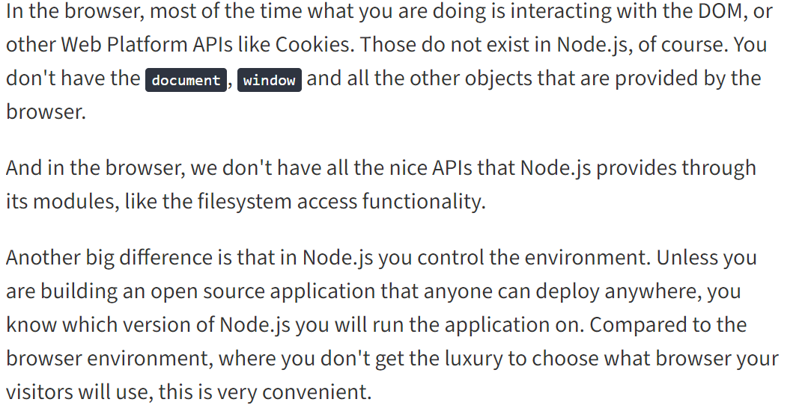
Differences between Node.js and the Browser
Both the browser and Node.js use JavaScript as their programming language. Building apps that run in the browser is a completely different thing than building a Node.js application. Despite the fact that it's always JavaScript, there are some key differences that make the experience radically different.
From the perspective of a frontend developer who extensively uses JavaScript, Node.js apps bring with them a huge advantage: the comfort of programming everything - the frontend and the backend - in a single language.
You have a huge opportunity because we know how hard it is to fully, deeply learn a programming language, and by using the same language to perform all your work on the web - both on the client and on the server, you're in a unique position of advantage.

Slide 32
Node.js
Node.js provides the facility to get process information such as process id, architecture, platform, version, release, uptime, upu usage etc. It can also be used to kill process, set uid, set groups, unmask etc.
The process is a global object, an instance of EventEmitter, can be accessed from anywhere.
Node.js Process Properties
A list of commonly used Node.js process properties are given below.
Property | Description
arch | returns process architecture: 'arm', 'ia32', or 'x64'
args | returns commands line arguments as an array
env | returns user environment
pid | returns process id of the process
platform | returns platform of the process: 'darwin', 'freebsd', 'linux', 'sunos' or 'win32'
release | returns the metadata for the current node release
version | returns the node version
versions | returns the node version and its dependencies

Slide 33
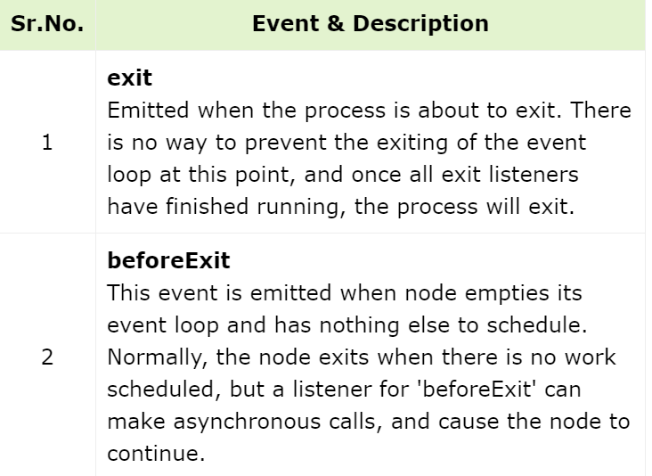
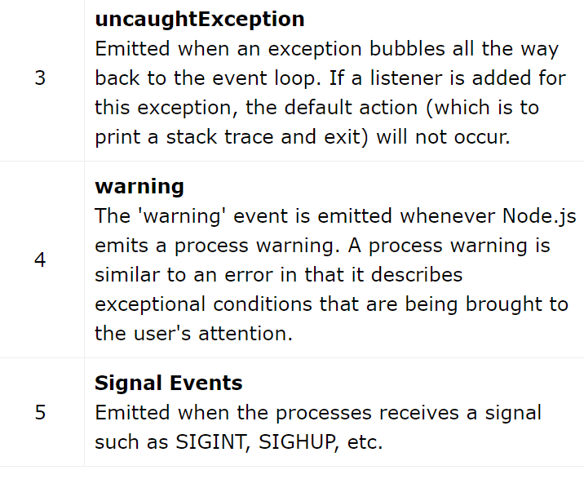
The process object in Node.js is a global object, although it is defined in process module. It is an instance of EventEmitter class. The process object provides information on current Node.js process. With the help of a number of methods and properties associated with this object, it is possible to control the current Node.js process.
Process Events
The process object is an instance of EventEmitter and emits the following events

Slide 34
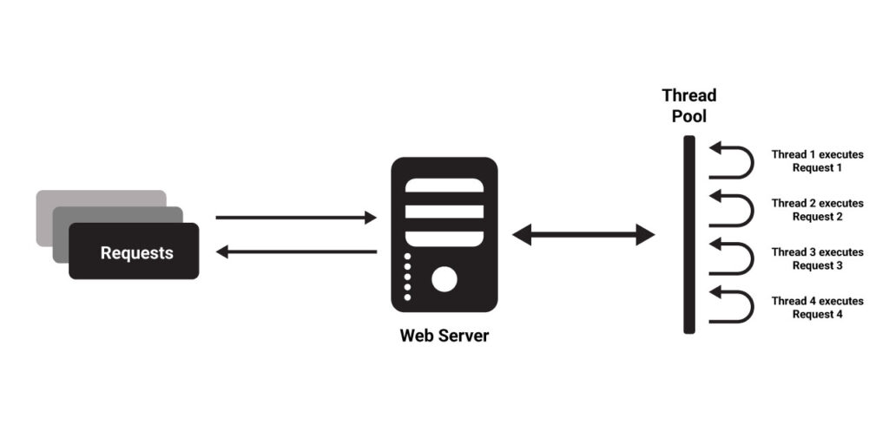
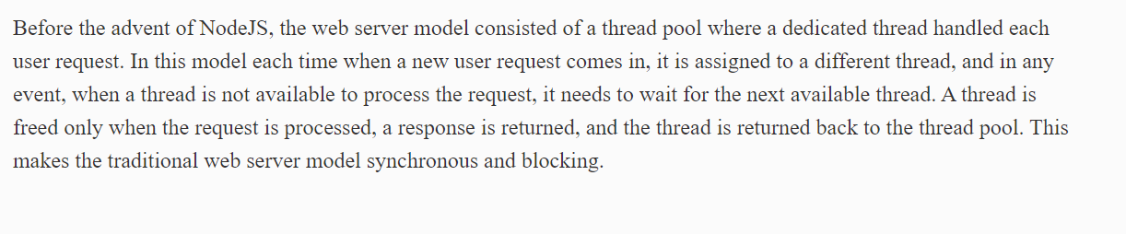
Traditional Web Server Model

Slide 35
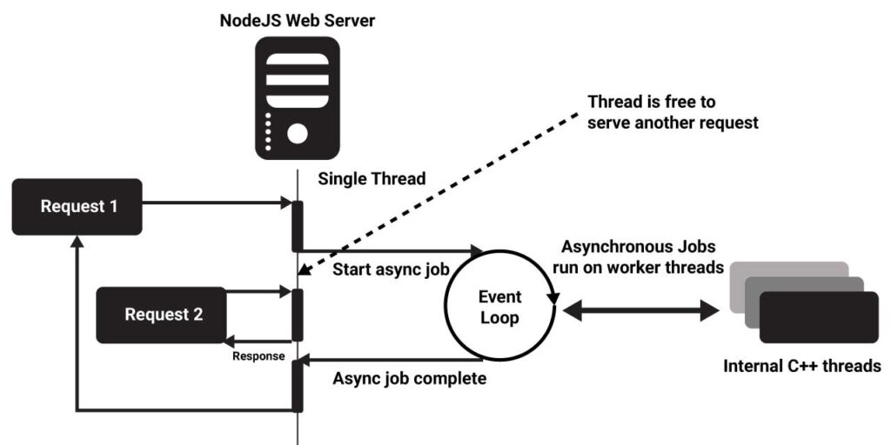
NodeJS Process Model

Slide 36
Contrary to the traditional web server model, NodeJS uses an event-driven, non-blocking I/O model that makes it lightweight and efficient. The NodeJS process model can be explained with three Modukles of NodeJS.
Single-threaded event loop
Non-Blocking I/O Model
Event-driven and Asynchronous by default
NodeJS has two types of threads: one Event loop also referred to as the main thread, and the k Workers also referred to as the background thread. When a new user request comes in, it is placed in an event queue.
Every request consists of a synchronous and asynchronous part.
The synchronous part of the request is handled on the main thread while the asynchronous part is handled in the background via the k Workers/ background threads.
Single Threaded Event Loop
NodeJS runs on a single-threaded environment which means each user request processes on a single thread only. This makes it use lesser resources and run smoothly using events and emitters.
Events are a crucial paradigm of the NodeJS process. Events are actions that instruct the runtime what and when something needs to be completed. Event Emitters are response object instances that can be subscribed to and acted upon to perform operations.
Event Emitters emit events based on certain predefined events accepting a callback. According to MDN web docs, event loops are responsible for executing the code, collecting and processing events, and executing queued sub-tasks.

Slide 37
Non-Blocking I/O Model
Blocking codes or operations are the ones that need to be completed entirely before moving on to another operation. Non-blocking codes are asynchronous and accept callback functions to operate.
As mentioned, every request has a synchronous and asynchronous part.
The main thread of NodeJS does not keep waiting for the background thread to complete the asynchronous I/O operations.
The main thread keeps switching between other requests to process their synchronous part while the background thread process the asynchronous part.
Event-Driven and Asynchronous By Default
Once the execution of the background thread is complete, the background thread emits events to notify the main thread.
Callback functions are associated with asynchronous processes. If the main thread is not free, the request waits for the main thread to be free and then takes up the callback request for further execution.
To provide concurrency, I/O events and callbacks, and other time-consuming operations are asynchronous by default. Node architecture uses libuv, a C library built specifically for NodeJS for handling most asynchronous I/O operations.

Slide 38
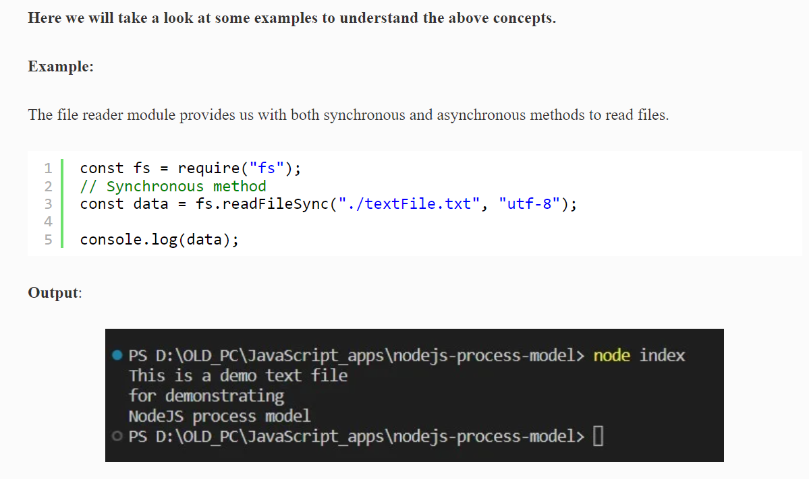

Slide 39
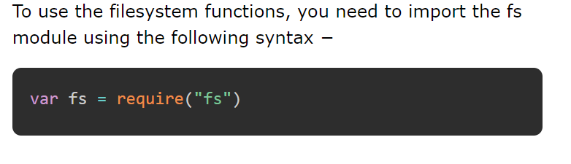
Node.js - File System
The Node.js API is a server-side programming technology. Hence, a Node.js application may be required to interact with the physical file system of the server.
The Node.js API includes fs module that enables the developer to perform read/write operations on disk files.
The fs module in Node.js provides synchronous as well as asynchronous methods for file handling.

Slide 40
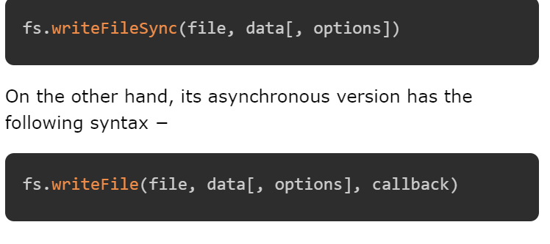
Synchronous vs Asynchronous
Every method in the fs module has synchronous as well as asynchronous version.
Asynchronous methods take the last parameter as the completion function callback and the first parameter of the callback function as error.
For example, the synchronous method for writing data in a file is −

Slide 41
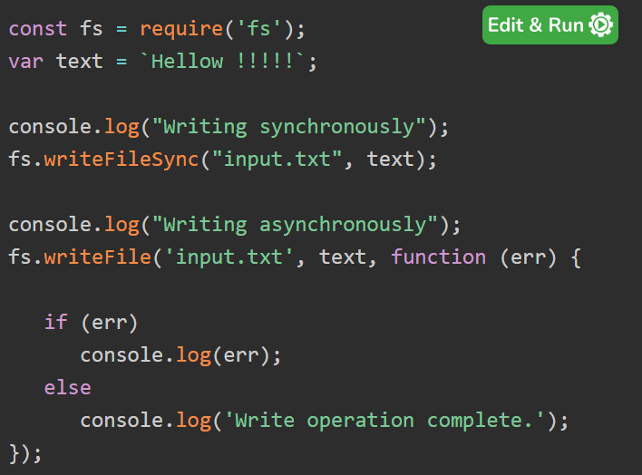
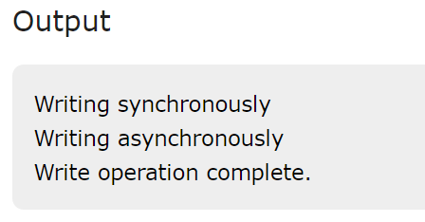
Writing a file
The following program shows how to write data in a file with synchronous as well as asynchronous methods.

Slide 42
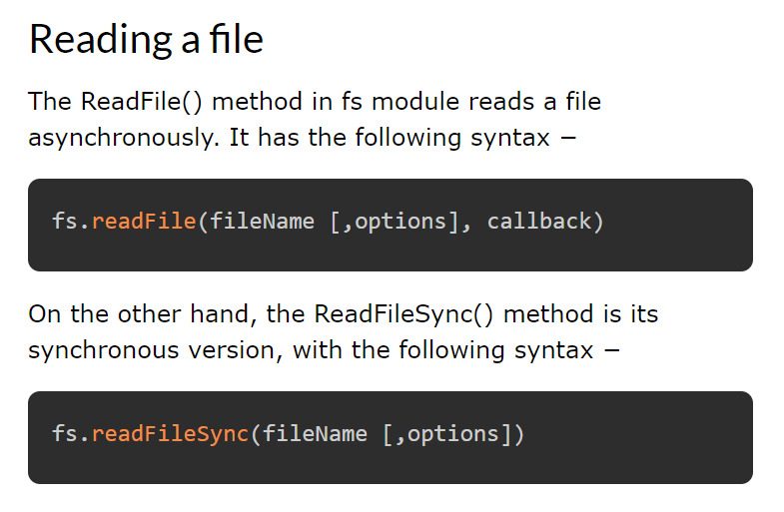

Slide 43
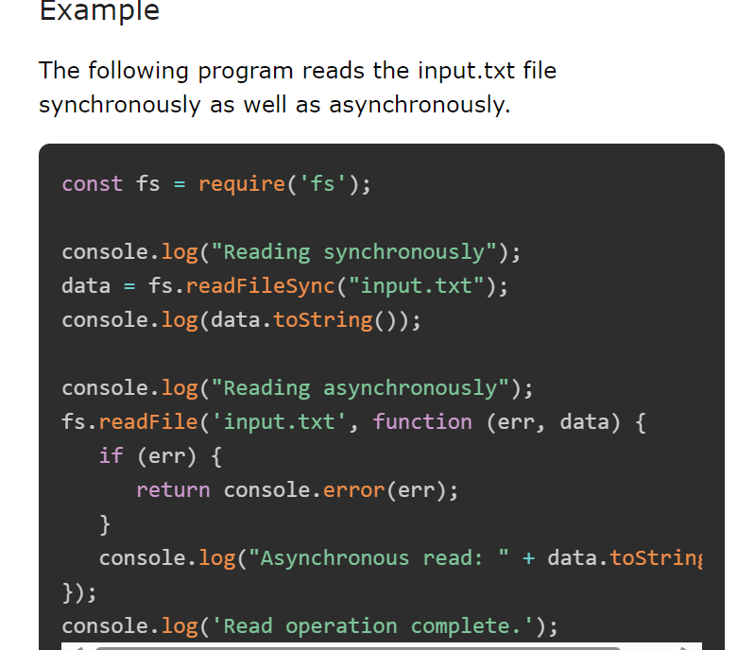

Slide 44
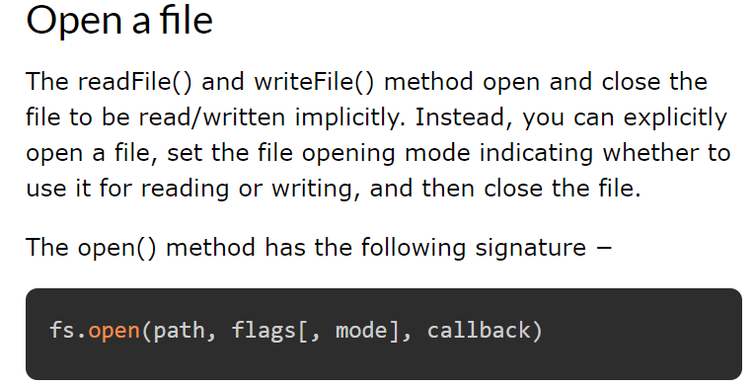
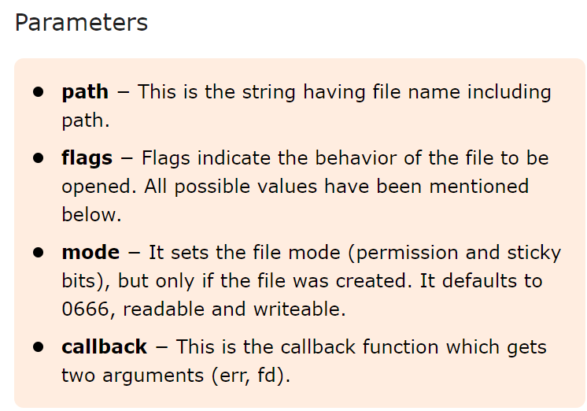

Slide 45
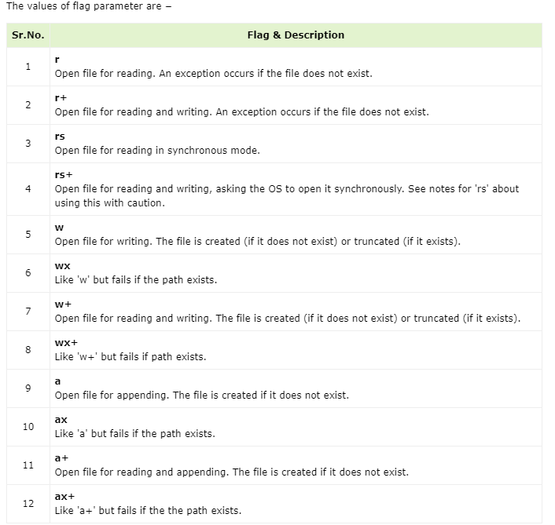

Slide 46
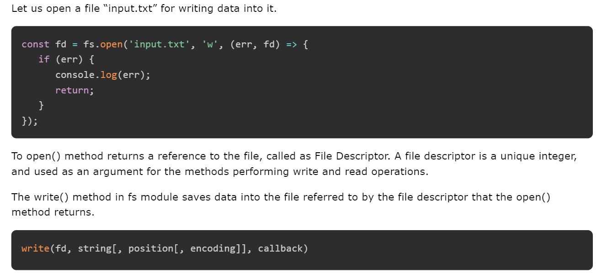
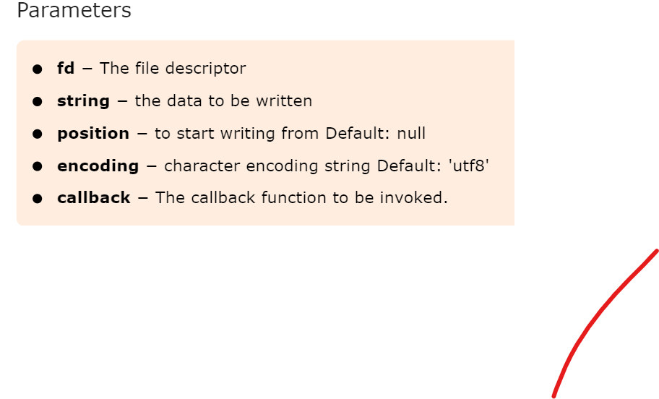

Slide 47
Node.js HTTP Module
The Built-in HTTP Module
Node.js has a built-in module called HTTP, which allows Node.js to transfer data over the Hyper Text Transfer Protocol (HTTP).
To include the HTTP module, use the require() method:
var http = require('http');
Node.js as a Web Server
The HTTP module can create an HTTP server that listens to server ports and gives a response back to the client.
Use the createServer() method to create an HTTP server:

Slide 48
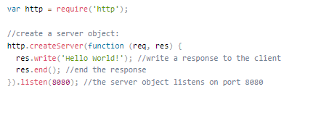
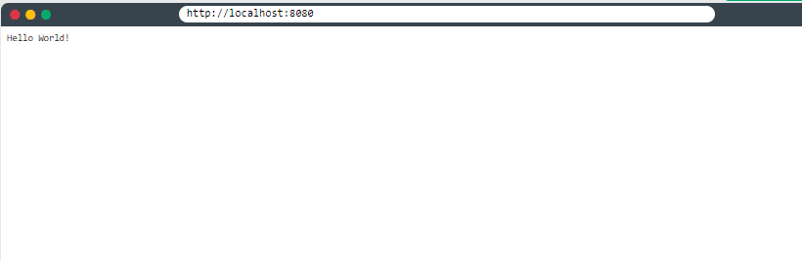

Slide 49

The function passed into the http.createServer() method, will be executed when someone tries to access the computer on port 8080.
Save the code above in a file called "demo_http.js", and initiate the file:

Slide 50
IMPORTANT QUESTIONS
Write a PHP program to greet the user based on time.
Explain how an array acts as an ordered map in PHP.
What are superglobal variables? Explain any five superglobal variables
Explain a)$this keyword b)instanceof in PHP
What is a constructor. Demonstrate constructor with suitable example.
Write a PHP program to demonstrate classes and objects in php.
Describe the relationship between keys and indexes in arrays.
How do you read or write a file on the server from PHP?
What classes of information are available via the $_SERVER superglobal array?
What is the role of error reporting in PHP? How should it differ for development sites compared to production sites?

Slide 51
Explain $_SERVER Array in detail
Explain $_GET and $_POST superglobal arrays
What is a class?Explain classes and objects in php
Illustrate how Errors are handled in PHP
How exceptions are handles in PHP.
Write a program to demonstrate error handling and exceptions in PHP.

